Slide 1
Graph Augmentation Summary
胡冬冬

Slide 2
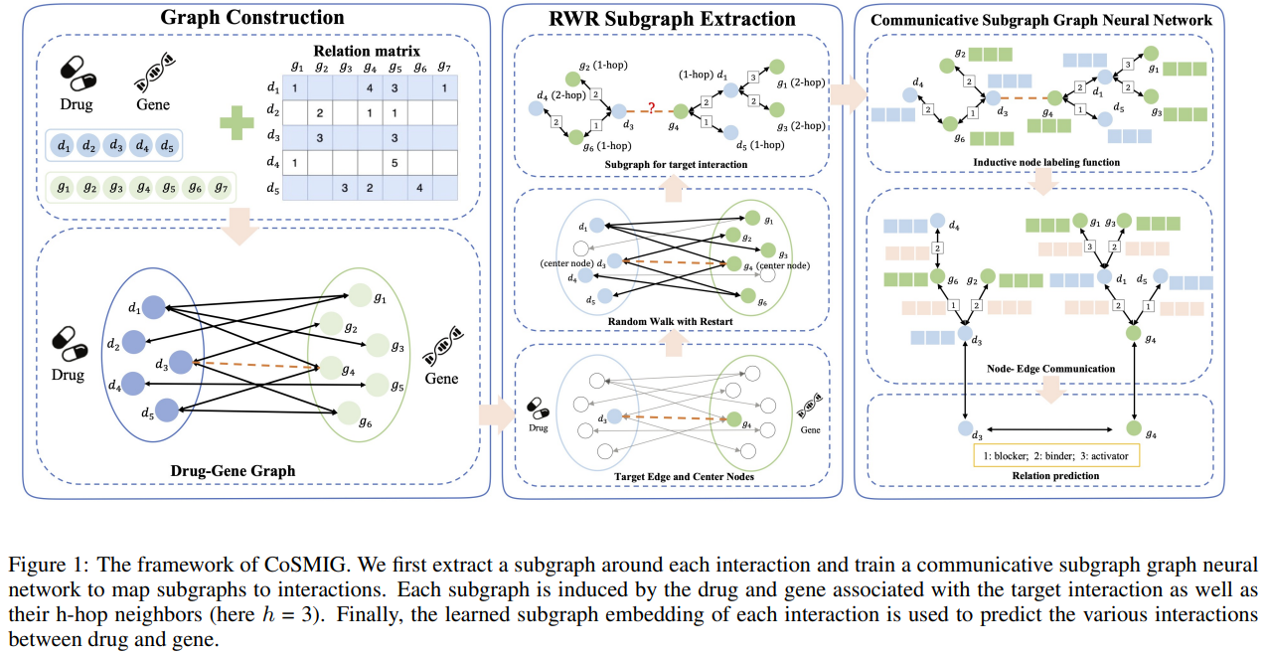
Communicative Subgraph Representation Learning for Multi-Relational Inductive Drug-Gene Interaction Prediction (SIGIR 2022)
Notes:
Compositions 成分
key concepts adjective-noun pairs

Slide 3
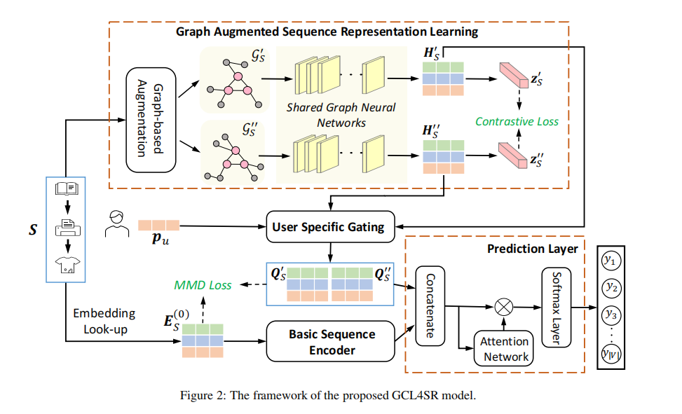
Enhancing Sequential Recommendation with Graph Contrastive Learning (IJCAI 2022)

Slide 4
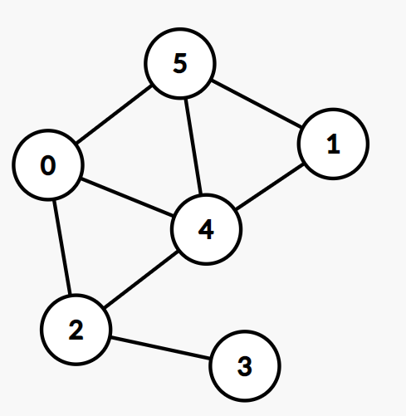
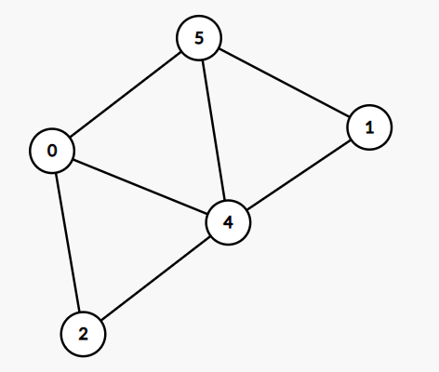
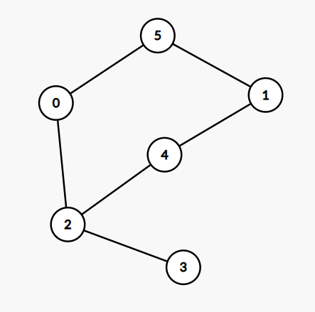
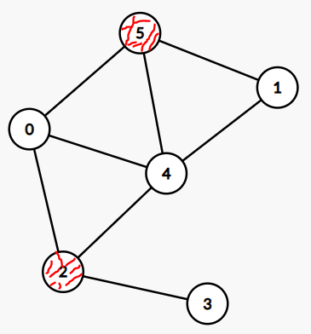
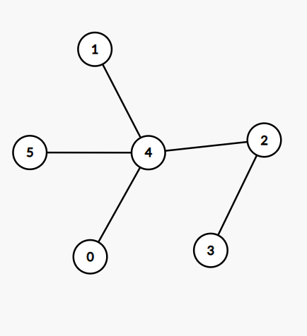
Dual Space Graph Contrastive Learning(WWW2022)
How to generate unique and informative views for graph contrastive learning?
Node dropping
Edge perturbation
Attribute masking
Subgraph

Slide 5
Thanks

